Slide 1


TVR: A Large-Scale Dataset for Video-Subtitle Moment Retrieval
Jie Lei, Licheng Yu, Tamara L. Berg, Mohit Bansal
UNC Chapel Hill
Notes:
Hello everyone, I am Jie. Today I am going to present our paper, TVR, A large-scale dataset for video-subtitle moment retrieval.
My collaborators are Licheng, Tamara and Mohit, we are from UNC Chapel Hill.

Slide 2
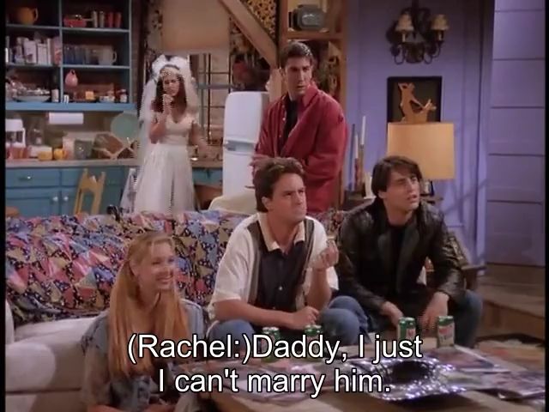
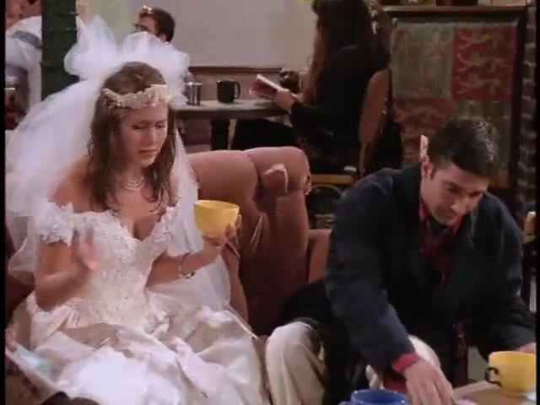
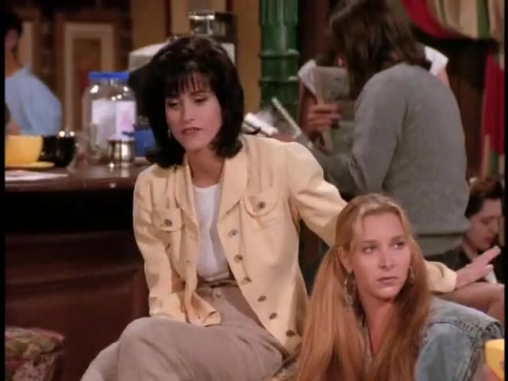
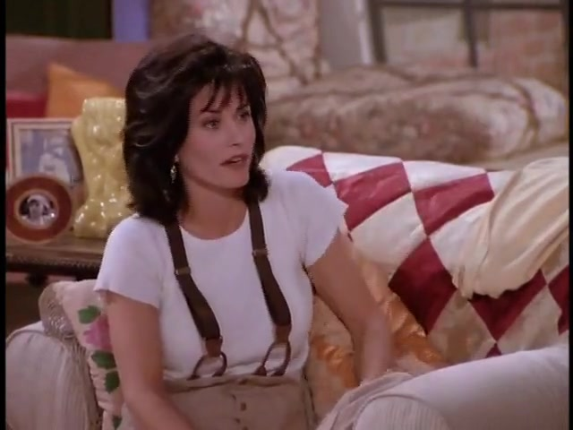
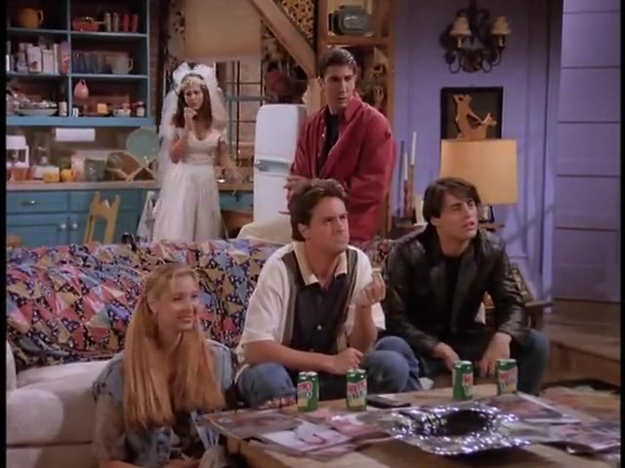
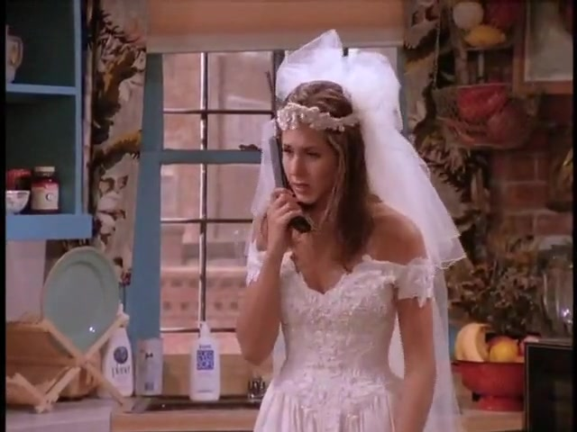
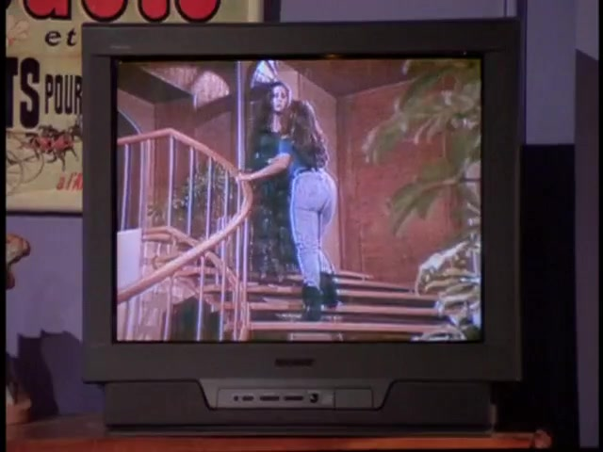
TVR Moment Retrieval Example
Query: Rachel explains to her dad on the phone why she can't marry her fiancé.
Query Type: video + subtitle
|
|
00:44
00:54
Notes:
TVR is a multimodal retrieval dataset. It is an unique dataset as it requires system to understand both videos and their subtitle (dialogue) texts.
Here we show a TVR example, the query is Rachel explains to her dad on the phone why she cant marry her fiancé, and the matched moment is [CLICK]. [Next]

Slide 3
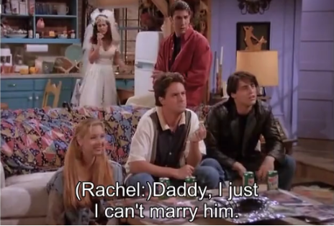
TVR Moment Retrieval Example
Query: Rachel explains to her dad on the phone why she can't marry her fiancé.
Query Type: video + subtitle
|
|
00:44
00:54
Notes:
As we can see, the part “on the phone” is more related to the visual content.

Slide 4
TVR Moment Retrieval Example
Query: Rachel explains to her dad on the phone why she can't marry her fiancé.
Query Type: video + subtitle
|
|
00:44
00:54
Notes:
While the part “explains to her dad why cant marry her fiance” is more reated to the dialogue subtitle. Thus, to more accuractly localize this query, a system needs to comprehend both the dialogue subtitle and the visual content.

Slide 5
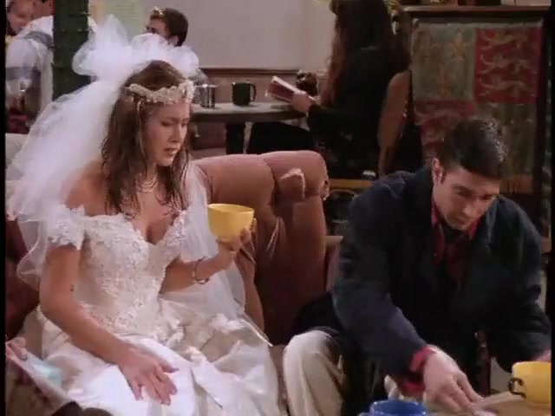
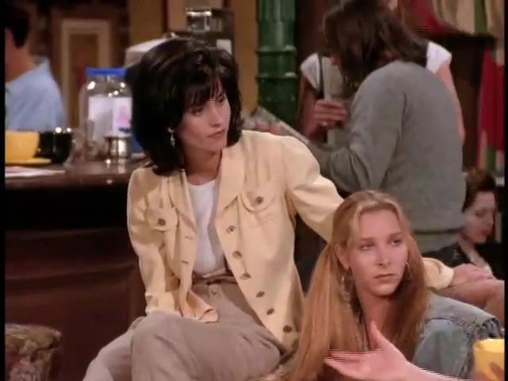
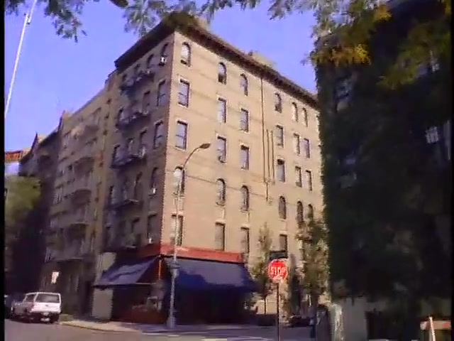
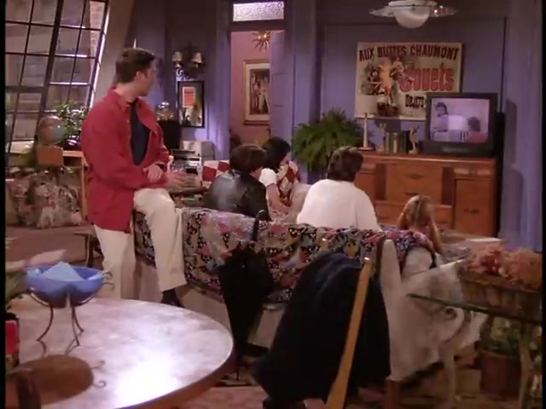
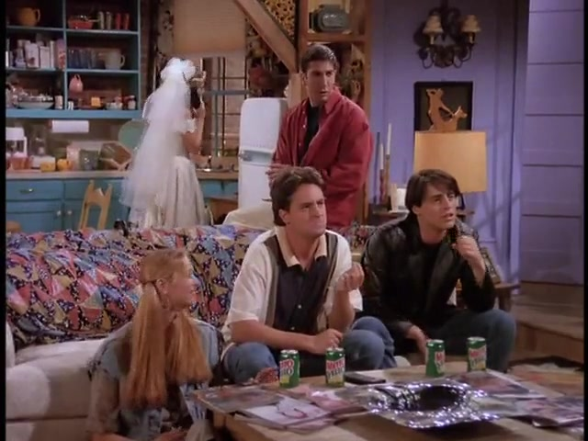
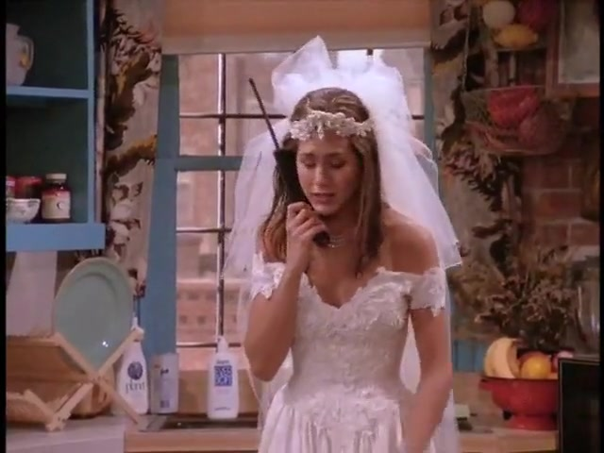
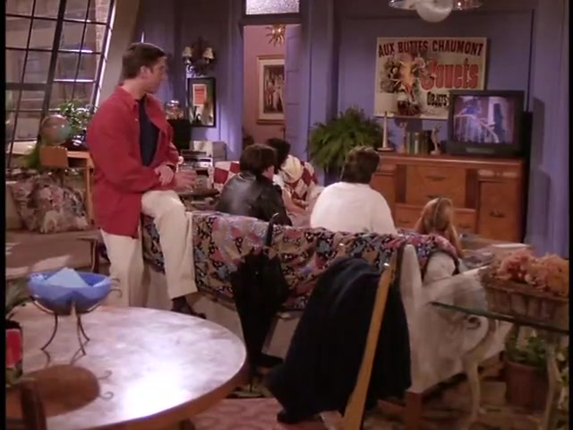

TVR Data Collection Procedure
00:00:07,786 --> 00:00:13,156
Monica: Who wasn't invited ...
00:00:35,180 --> 00:00:37,774
"Tuna or egg salad! Decide!"
00:00:44,223 --> 00:00:52,929
Rachel: Daddy, I can't marry him…
00:00:58,771 --> 00:01:05,032
"If I let go of my hair, …"
…
…
…
00:00
00:44
00:54
00:60
Query: Rachel explains to her dad on the phone why she can't marry her fiancé.
Query Type: video + subtitle
Notes:
To collect the queries, we present annotators a 60 seconds-long video with associated dialogue subtitles to encourage them writing queires requiring both modalities.
[CLICK] They are required to find an interesting moment in the video and mark its start-end. [CLICK] and then write a query that desciribe the marked moment. [CLICK] In addition, they are also required to mark the type of the query – whether the query is more related to video or subtitle or both.

Slide 6





TVR Data Collection Procedure
Notes:
To collect high-quality annotations, we adopt the following collection procedure with a set of checks and tests. [CLICK] At step 1, we use a a qualification test of 12 questions to make sure workers understand our requirements.
[CLICK] At step2, qualified workers perform annotation following our instructions. [CLIKC] Then, at step 3, our automatic checker perform basic checks such as whether all the blanks are correctly filled and the description is at least 8 words long.
[CLICK] At step 4, we peform in house manual check of the queries, Disquafied queries are re-annotated and workers with disqualified queries were removed from our worker list.
[CLICK] Lastly, at step 5, to verify the annotation quality, we also performed a post-annotation verification experiments.

Slide 7
TVR Data Ananlysis
TVR is the largest moment retrieval dataset, containing 109K human annotated query-moment pairs on 22K videos.
It is the only moment-retrieval dataset requiring both video and subtitle context and with query type annotations.
It also has a much larger vocab size, making textual understanding challenging.
Notes:
With this strict data collection procedure, [CLICK] we collected 109K human annotated query-moment pairs on 22K videos, making it the largest dataset of its kind.
TVR is the only moment retrieval dataset that requires both video and subtitle context [CLICK] , and it is also the only one with query type annotations. These query type annotation could be used for deeper analysis of the datasets and models. We show distribution of TVR query type on the right.
In addition, it also has a much larger vocabulary size [CLICK], making textual understanding challenging.

Slide 8
TVR Data Ananlysis
Distributions of moment (left) and query (right) lengths.
Compared to existing datasets, TVR has relatively shorter (video-length normalized) moments and longer queries.
Notes:
Compared to existing datasets, TVR has relatively shorter (video-length normalized) moments [CLICK] and longer queries. [CLICK]

Slide 9
TVR Data Ananlysis
Percentage of queries that have multiple actions or involve multiple people. We also show query examples, with unique person mentions underlined and actions in bold
Compared to existing datasets, TVR queries typically have more people and actions and require both video and sub (subtitle) context.
Notes:
Here we show the percentage of queries that have multiple actions or involve multiplpe people. Compared to existing datasets, TVR queries typically have more people and actions and require both video and sub (subtitle) context

Slide 10
TVR Task
Video Corpus Moment Retrieval (VCMR)
A query + A video corpus Retrieve the matched moment from the corpus.
Retrieve the GT video. (Video Retrieval)
Localize the moment from the retrieved video. (Single Video Moment Retrieval)
Notes:
Our task is video corpus moment retrieval, given a language query and a large video corpus, [CLICK] our goal is to retrieve the matched moment from the corpus.
It requires not only retrieve the GT video, but also localize the moment from the retrieved video.

Slide 11
Our Model: Cross-modal Moment Localization (XML)
Notes:
To solve this task, we propose Cross-modal moment localization, XML model.
[CLICK] It performs video-level retrieval at its lower layers.
[CLICK] and fine-grained moment-level retrieval at its deeper layers with a novel convolutional start-end detector module.
[CLICK] scores from both sides are aggregated together to generate the final scores.

Slide 12
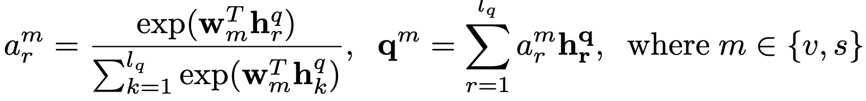
Our Model: Cross-modal Moment Localization (XML)
Query Encoding
Encode using RoBERTa and Transformer Encoder: .
We use two trainable weight vectors to aggregate the information of to generate modularized query vectors :
Notes:
Our XML model first encodes the query sentence using transformer encoders, the encoded embeddings are then aggregated with two trainable weight vectors to generate two modularized query vectors, for video and subtitle, respectively.

Slide 13
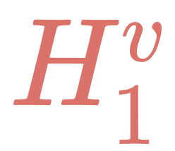

Our Model: Cross-modal Moment Localization (XML)
Context Encoding
We extract video and subtitle feature from I3D, ResNet and RoBERTa models.
We encode both context similarly with transformer encoders.
The lower layer features are used for video-level retrieval.
The deeper layer features are used for moment-level retrieval.
Notes:
For context, we extract prertained vision and language features and then encode them using transformer encoders.
We use lower layer features for video-level retrieval
We use deeper layer features for more fine-grained moment level retrieval.

Slide 14
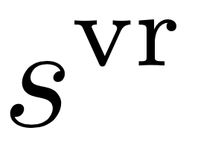
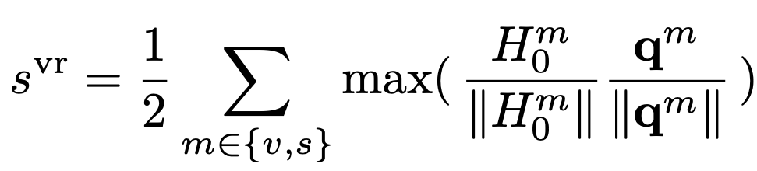
Our Model: Cross-modal Moment Localization (XML)
video
subtitle
Video Retrieval
We compute video retrieval score :
Notes:
we compute video retrieval score by computing score for each modality and then average them together as the final score. We train video retrieval with a ranking loss.

Slide 15
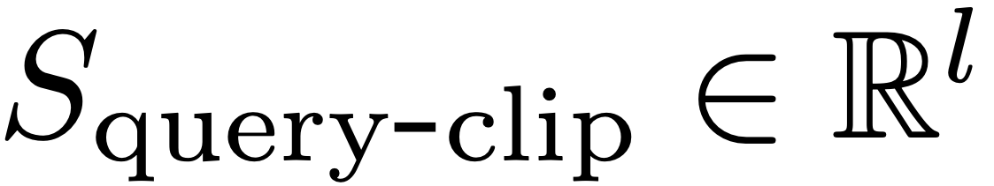
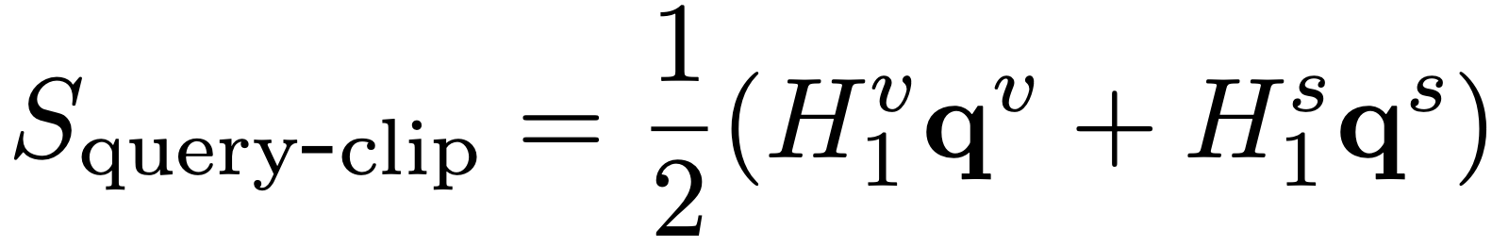
Our Model: Cross-modal Moment Localization (XML)
video
subtitle
Single Video Moment Retrieval
We first compute query-clip similarity scores :
Notes:
For single video moment retrieval, we first compute query-clip similarity scores with inner product.

Slide 16
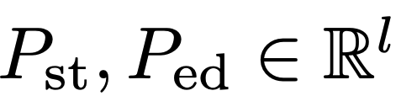
Our Model: Cross-modal Moment Localization (XML)
Single Video Moment Retrieval
We first compute query-clip similarity scores .
We then apply Convlutional Start-End (ConvSE) detector:
The scores are normalized with softmax to output the probabilities .
Notes:
We then apply our ConvSE module, which are essentially two 1D convolutional kernels to detect the start and end edges in the similarity score curve. [CLICK]
The intuition here is that clips inside a semantically close span will have higher similarity to the query than those outside, naturally form detectable edges around the span.
The filter scores are then normalized with softmax to output probabilities of each position being the GT position, this module is trained to maximize the scores of the GT positions with cross-entropy.

Slide 17
Our Model: Cross-modal Moment Localization (XML)
Video Corpus Moment Retrieval
Aggregate video-reteival score and single video moment retrieval score:
Notes:
To generate corpus level scores, we aggregate the video reteival scores and moment level scores together.

Slide 18
Experiments
Data:
We split TVR into 80% training, 10% validation, 5% test-public, 5% test-private (reserved)
Metrics
Recall at K (R@K). A prediction is correct if
Predicted video matches the GT video;
Predicted moment span has high Intersection-over-Union (IoU) with GT span.
Notes:
We split TVR into 80% training, 10% validation and 5% test-public for reporting at our leaderboard, 5% test-private is reserved for future challenges.
We use Recall at K as our metric. A prediction is correct if (1) Predicted video matches the GT video and the (2) Predicted moment span has high Intersection-over-Union (IoU) with GT span.

Slide 19
Experiments
Baseline comparison on TVR test-public set, VCMR task.
Notes:
Experiments show that our proposed XML model outperform previous baseline method by a large margin [CLICK] and with better efficiency [CLICK].

Slide 20
Experiments
Performance of XML models that use only video, subtitle, or both as inputs.
Use both video and subtitle performs the best.
Notes:
Here we show performance of XML models that use only video, subtitle or both as inputs.
We can see from the figure that [CLICK] using both video and subtitle performs the best.

Slide 21
Experiments
Performance breakdown of video-only, subtitle-only, video+subtitle XML models on different query types (with percentage of queries shown in brackets)
video-only
sub-only
sub-only
video-only
Notes:
Here we show performance breakdown of XML models on different query types.
For queries that are labeled as video-only, [CLICK] video-only model performs better than subtitle-only model. [CLICK] And we will reach the opposite conclusion when we look at the performance on subtitle-only queries.

Slide 22
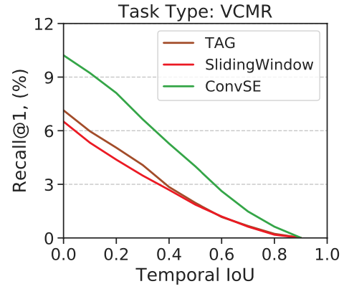
Experiments
Performance comparison of moment generation methods, under the same XML backbone.
TAG and SlidingWindow rely on handcrafted rules, while ConvSE learns from data.
ConvSE performs consistently better across different IoU thresholds.
Notes:
Performance comparison of moment generation methods, under the same XML backbone.
TAG and SlidingWindow rely on handcrafted rules, while ConvSE learns from data for more accurate localization.
The results show ConvSE performs consistently [CLICK] better across different IoU thresholds

Slide 23
Experiments
Examples of learned ConvSE filters applying on query-clip similarity scores.
Notes:
Here we show Examples of learned ConvSE filters applying on query-clip similarity scores.
The filters output stronger responses to the up (Start) and down (End) edges of the score curves and thus detect them.
Interestingly, the learned filter weights [CLICK] are similar to the edge detectors in image processing.

Slide 24
Experiments
Notes:
Here we show two XML prediction examples, we see our model is able to correctly localize moments using both video and subtitle information.
Additionally, we also found XML gives high modular attention scores to visible nouns when the input is video, for example, in the top-left corner [CLICK], we see waitress, restaurant and menu receives higher modular attention scores.
For subtitle, words that are related to the the dialogues are given higher weights, such as Rachel and menu.

Slide 25

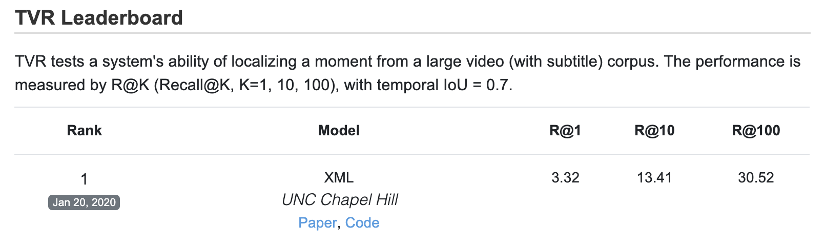


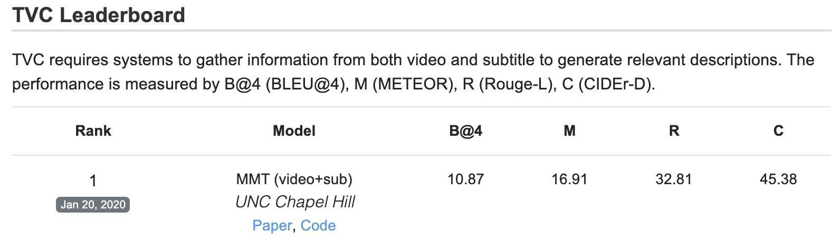
Data & Code Release
TV show Retrieval (TVR):
https://tvr.cs.unc.edu/
https://github.com/jayleicn/TVRetrieval
Linear &
Softmax
TV show Captions (TVC):
-- We collected additional descriptions for each TVR moment.
Linear
Linear &
Softmax
https://tvr.cs.unc.edu/tvc.html
https://github.com/jayleicn/TVCaption
Notes:
Our TVR dataset and code are publicly available. We also collected additional description for each TVR moment, forming a new multimodal captioning dataset, named TVC. In TVC, systems have to use information from both the dialogue subtitles and the videos to generate captions. For both datasets, we host public leaderboards to better compare the methods. [Next ] Thanks for your attention!

Slide 26
Thanks!
Linear &
Softmax
Linear
Linear &
Softmax
Notes:
Thanks for your attention!

